Slide 1

E-COPS
(Police Online Crime Investigation System)
Submitted in
Partial fulfillment of the Requirement of the
Degree of Bachelor of Technology
IN
COMPUTER SCIENCE ENGINEERING
Submitted by:
Ayush Sharma
16BCS1550
DEPARTMENT OF COMPUTER SCIENCE & ENGINEERING
Chandigarh University, Gharuan

Slide 2
CONTENTS
INTRODUCTION
OBJECTIVES
HARDWARE AND SOFTWARE REQUIREMENTS
PHP DEVELOPMENT DIAGRAM
DATA FLOW DIAGRAMS
ER DIAGRAMS
DATABASE STRUCTURE
SNAPSHOTS
CONCLUSIONS AND FUTURE WORK

Slide 3
INTRODUCTION
E-cops or police management system is a system which provides user a very easy access to the police crime investigation or crime solving system. In this project we provide a simple way to register or report a crime. This will very helpful in sensitive situation.
In this account all the information is present like name, complaint, officer which handled the case, progress of the case etc. Our main motive is to provide an easy accessible service to the citizen, so that they can directly interact with our investigation system.
In this E-cops system we use XAMPP 3.2 server with php. Also HTML And CSS is used for making this project. In this project we ensure more interactions between user and System. This application offer many services for user.

Slide 4
REQUIREMENTS
Hardware Requirements
Window platform like:2000 professional, XP, 7.
HDD-100GB or above.
RAM- 1GB or above.
Processor Speed-1.2 GHz or above.
Software Requirements
MySQL
XAMPP 1.7.1
HTML,CSS,Jscript
Php

Slide 5
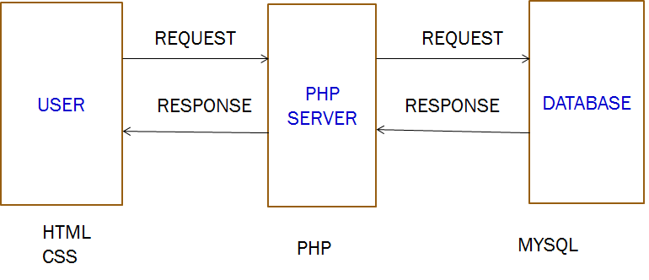
PHP DEVELOPMENT DIAGRAM
Fig: PHP DEVELOPMENT DIAGRAM

Slide 6
DATA FLOW DIAGRAMS
E-COPS
Investigatory System
User ID, Complaints
Complaint Management
User
Administrator
Solutions, Feedback
Fig: 0-LEVEL DFD

Slide 7
Contd…
Administrator
Registration details
User name, Password
View user details
Login
Online Crime File System
View Complaints
Complaints
Add Solutions
View Feedback
User
Feedback
Add FIR Reports
FIR
Fig:3-level DFD Administrator

Slide 8
Contd…
Registration
User
Registration
Username/Password
Login
Username/Password
Login
Verify
Complaint Registration
Complaints
Complaints
Fig: 4 - Level DFD User

Slide 9
Cotd…
Administrator
View complaints
Complaints
Complaint Details
FIR Management
FIR No: Details
Login
FIR
FIR Details
Report Generation
Add Reports
Reports
View Reports
User
Fig:`5 DFD User

Slide 10
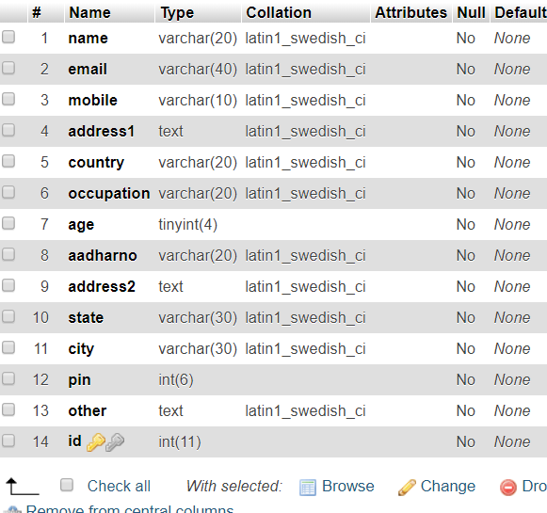
DATABASE STRUCTURE TABLE NAME: register_user
The table Register_complaints stores the information of the registered user
Id is auto incremented.

Slide 11
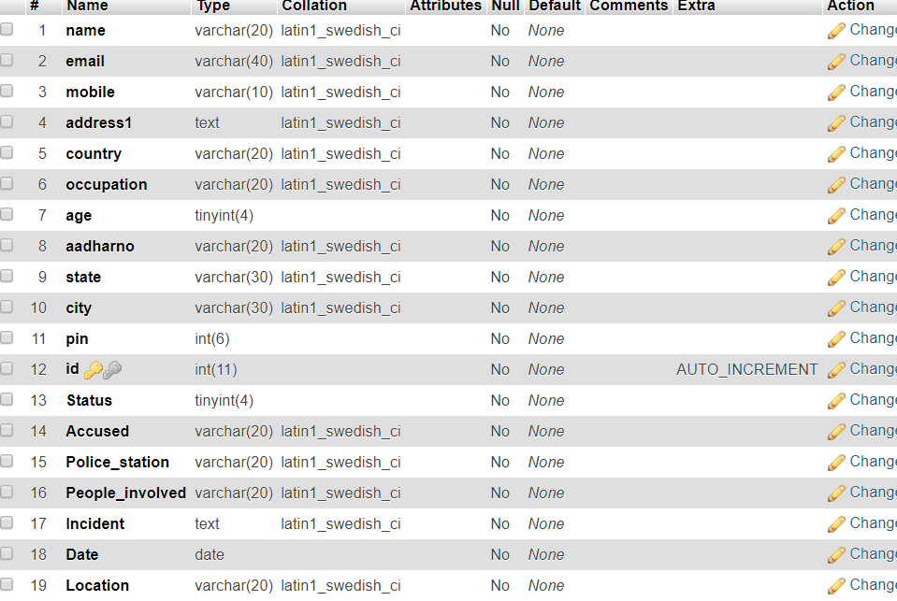
TABLE NAME: Register_Crime
Contains Registered Complains

Slide 12
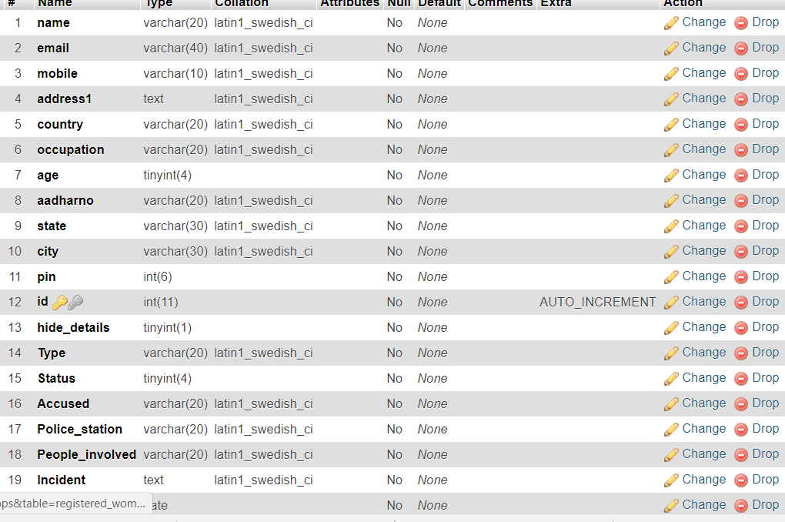
TABLE NAME: Register_women
Contains special complaints of womens

Slide 13
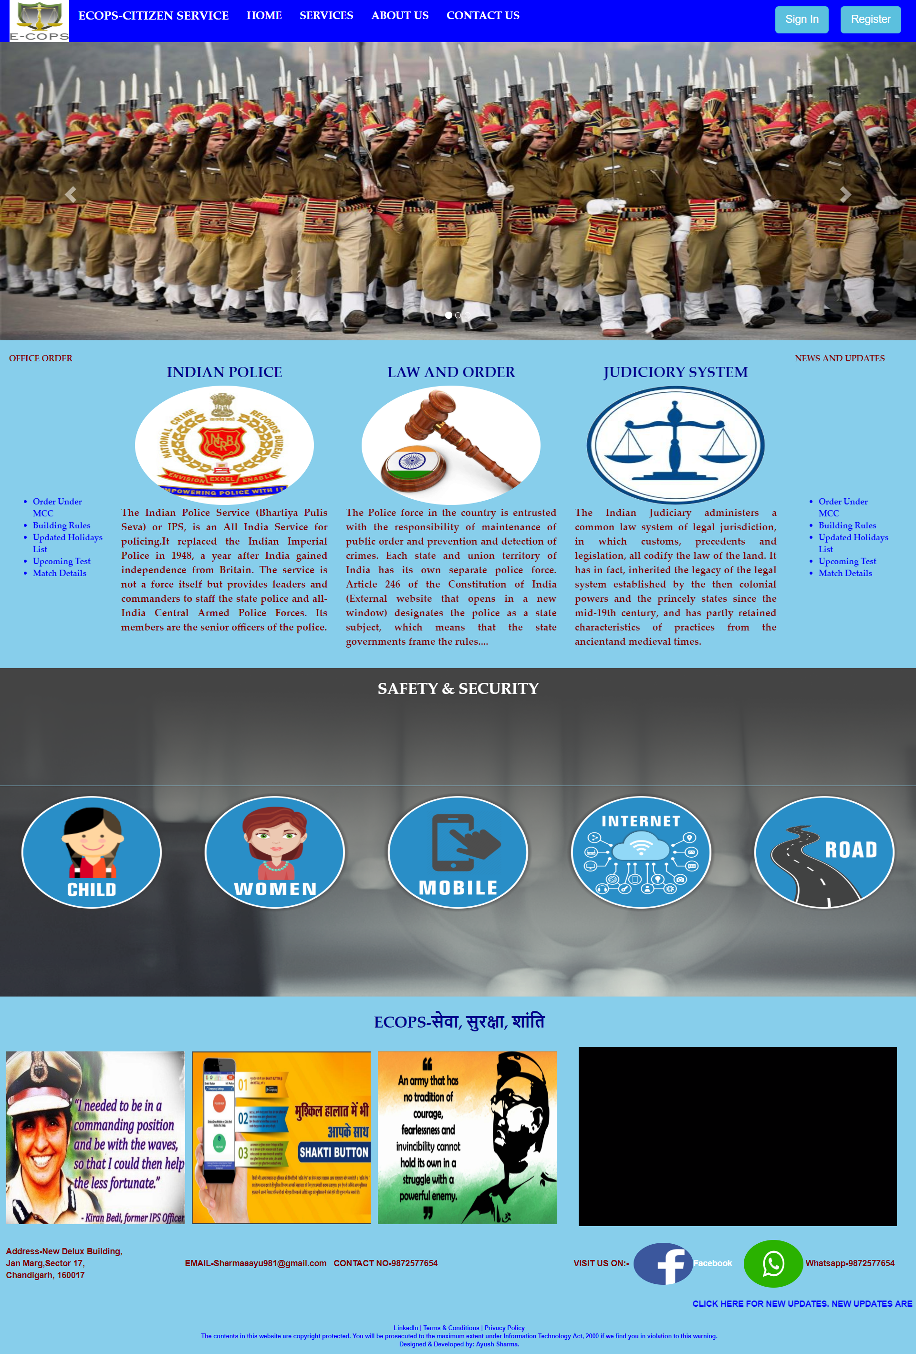
SNAPSHOTS
PAGE 1:INDEX PAGE
Home Page

Slide 14
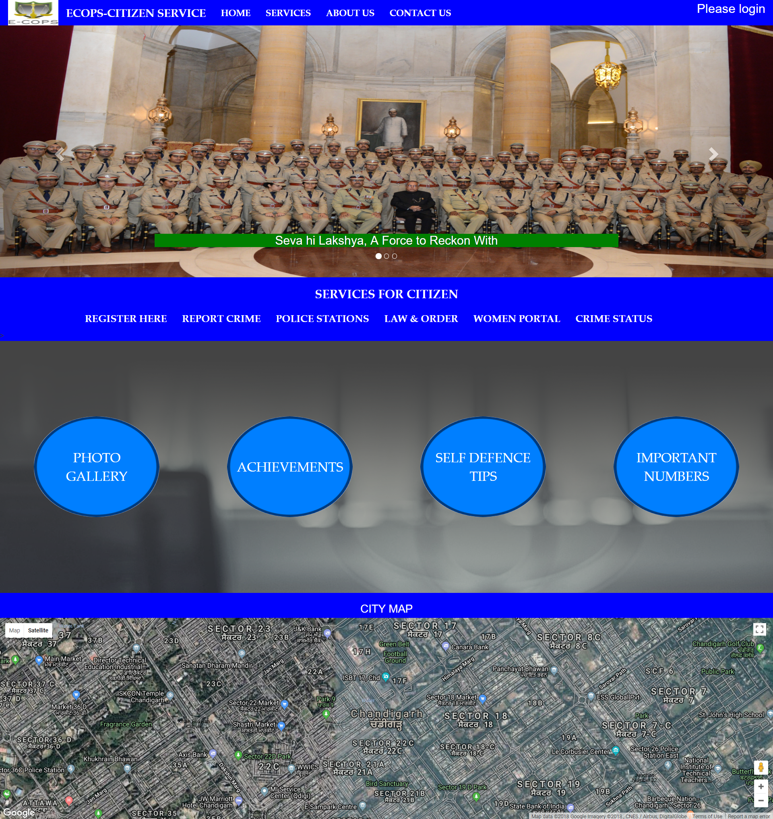
PAGE 1:INDEX PAGE

Slide 15


Slide 16
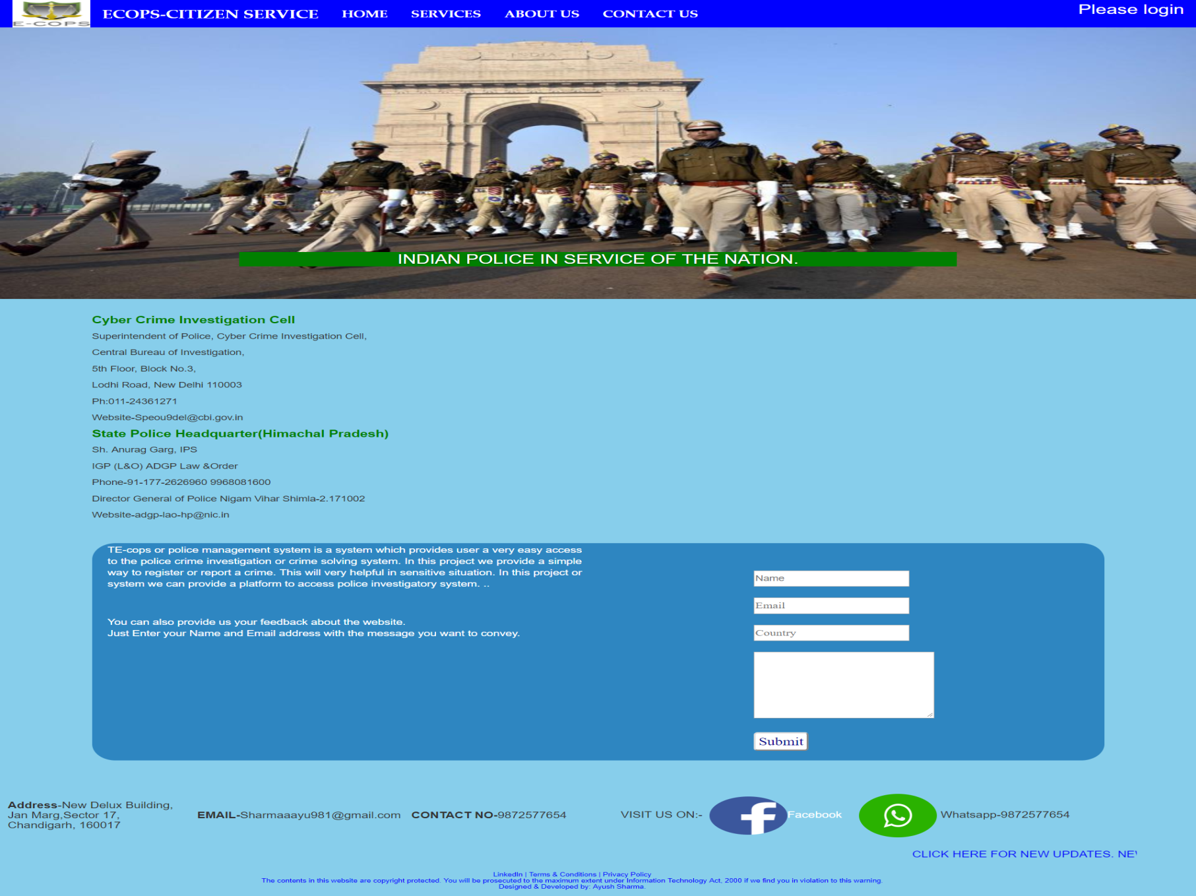
Contact Us

Slide 17
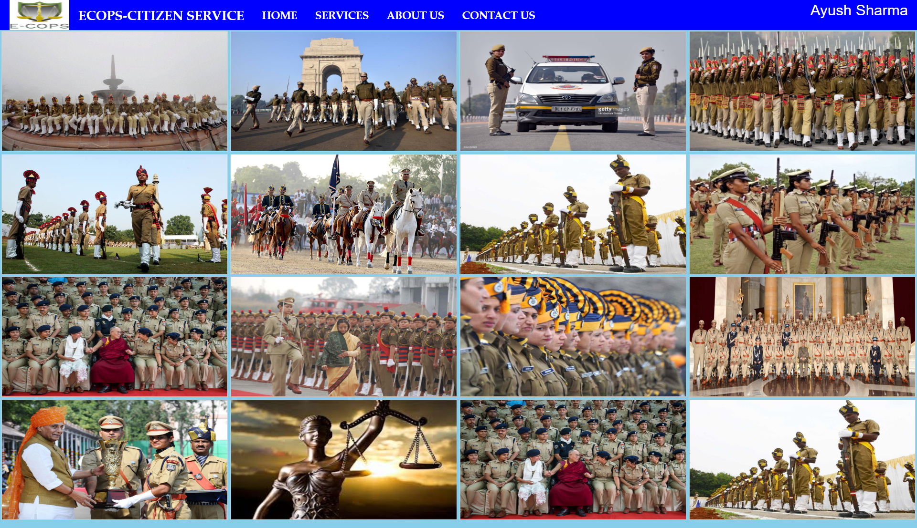
PAGE 1:INDEX PAGE
Picture Gallery

Slide 18
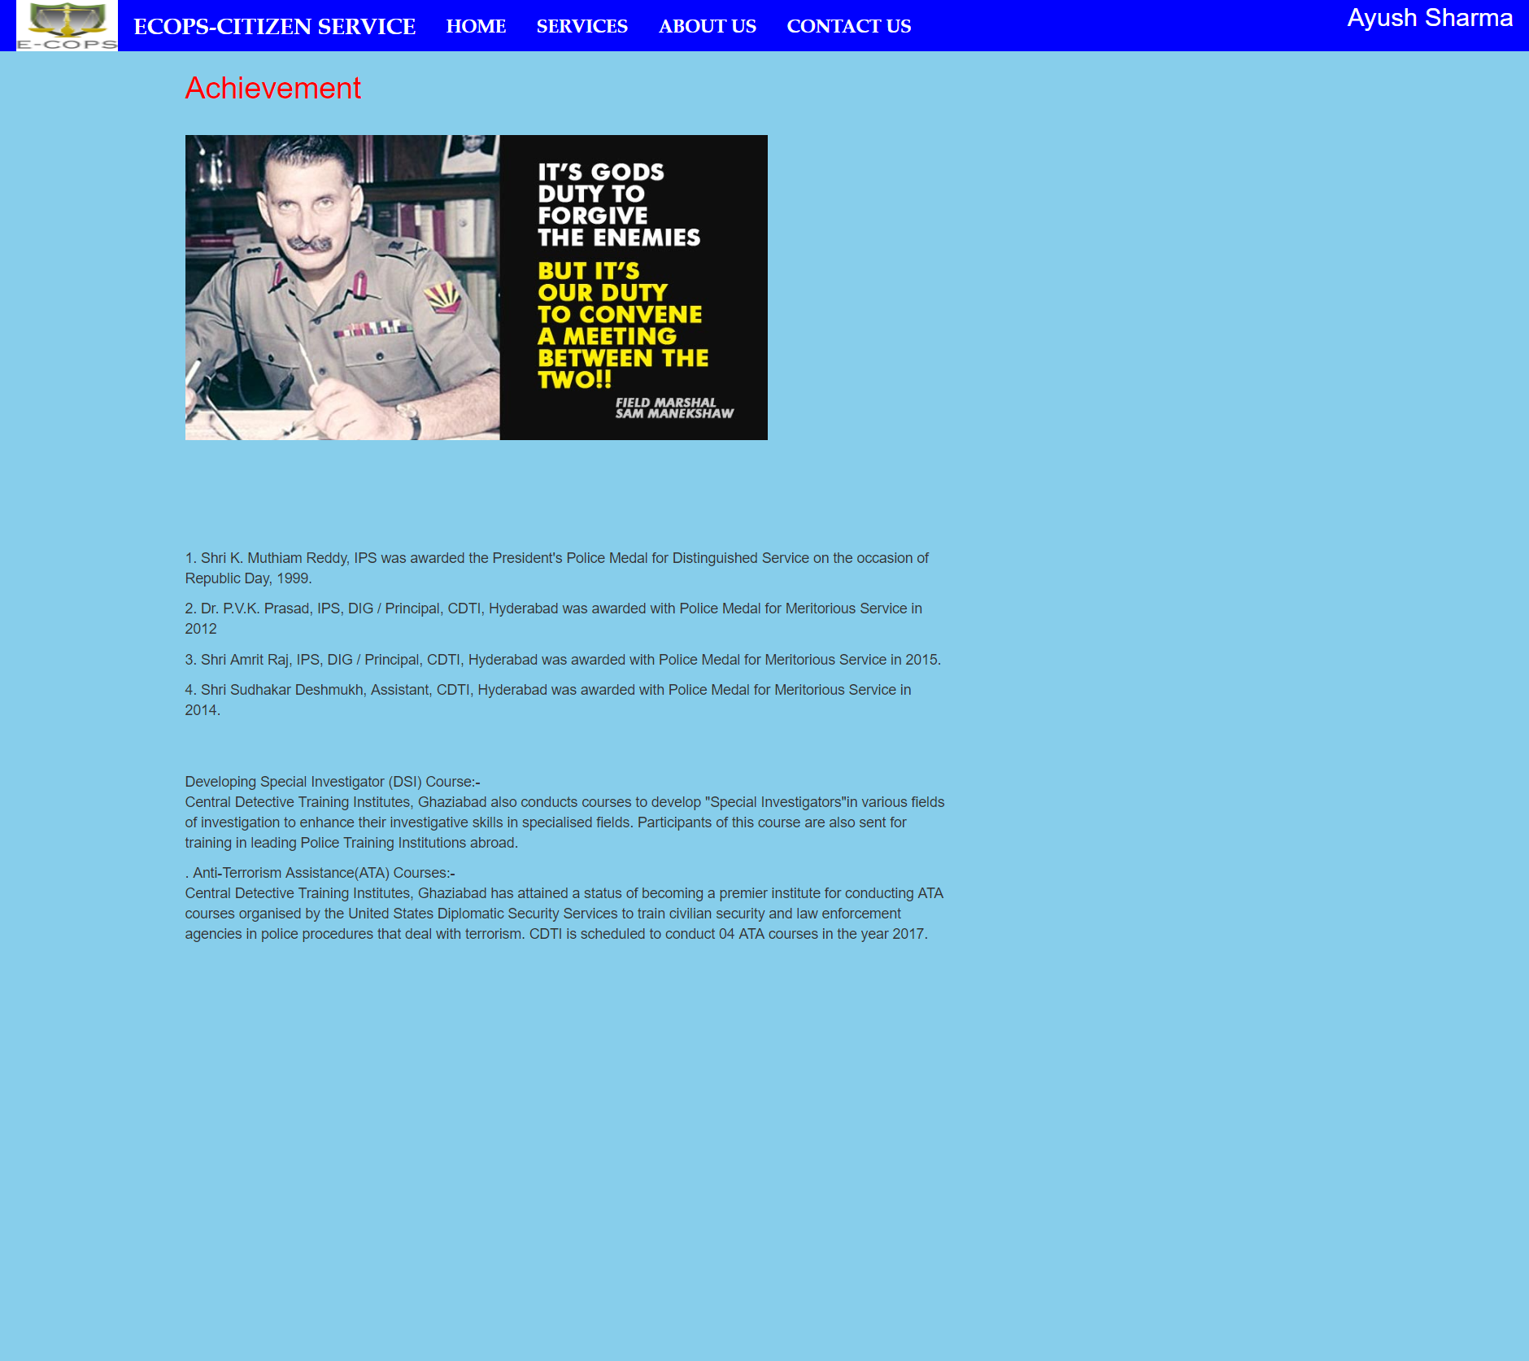
PAGE 1:INDEX PAGE
Achievements

Slide 19

PAGE 1:INDEX PAGE
Self Defense Tips

Slide 20
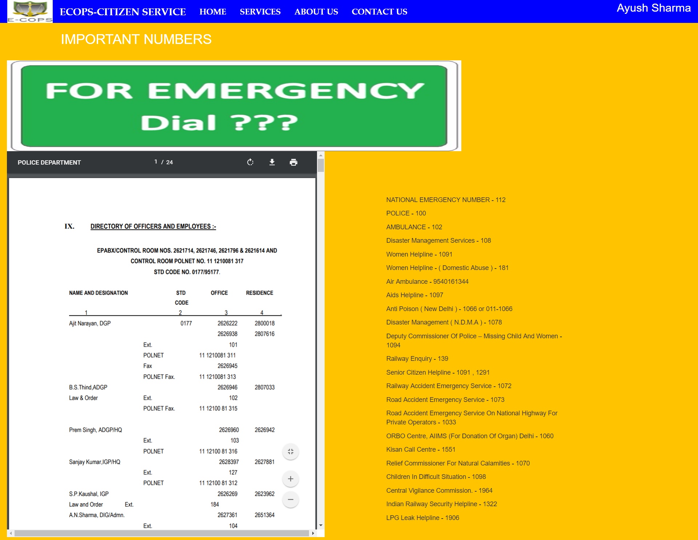
PAGE 1:INDEX PAGE
Emergency Numbers

Slide 21
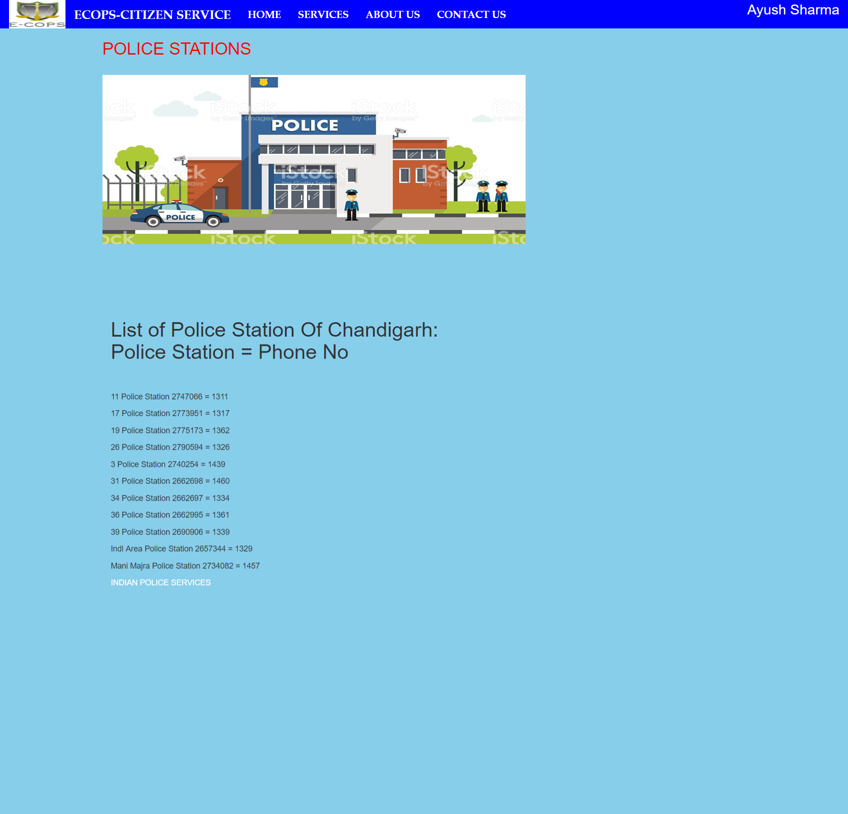
PAGE 1:INDEX PAGE
Nearby Police station Contact

Slide 22
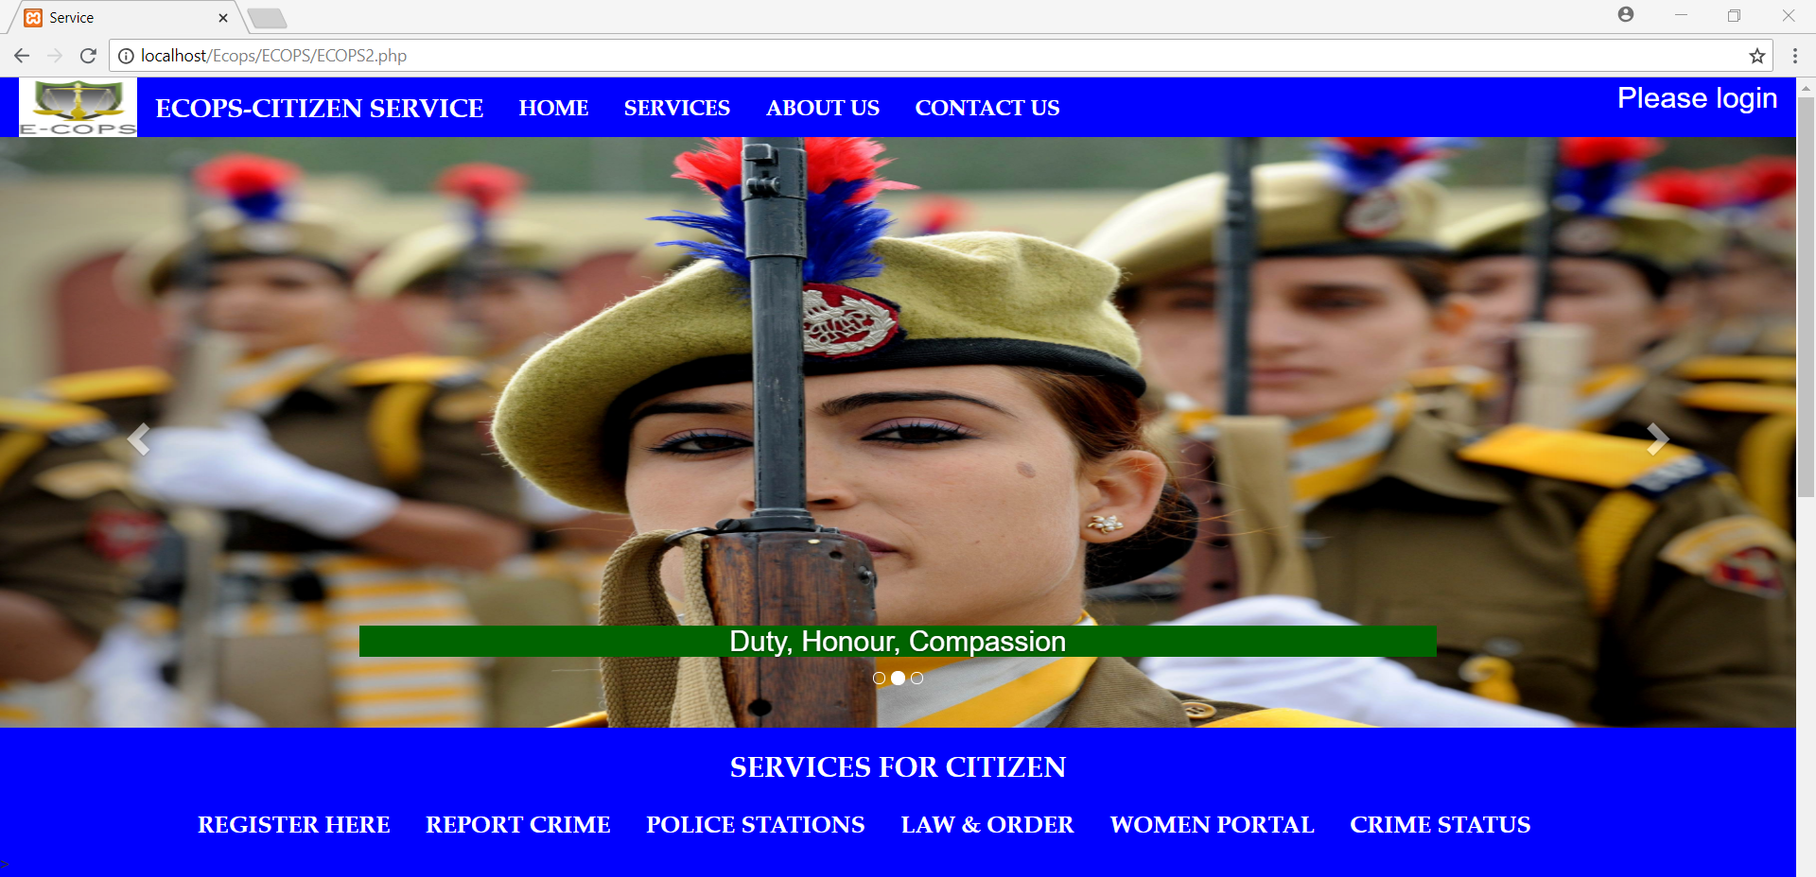
SNAPSHOTS
Main Page (Citizen Services)

Slide 23
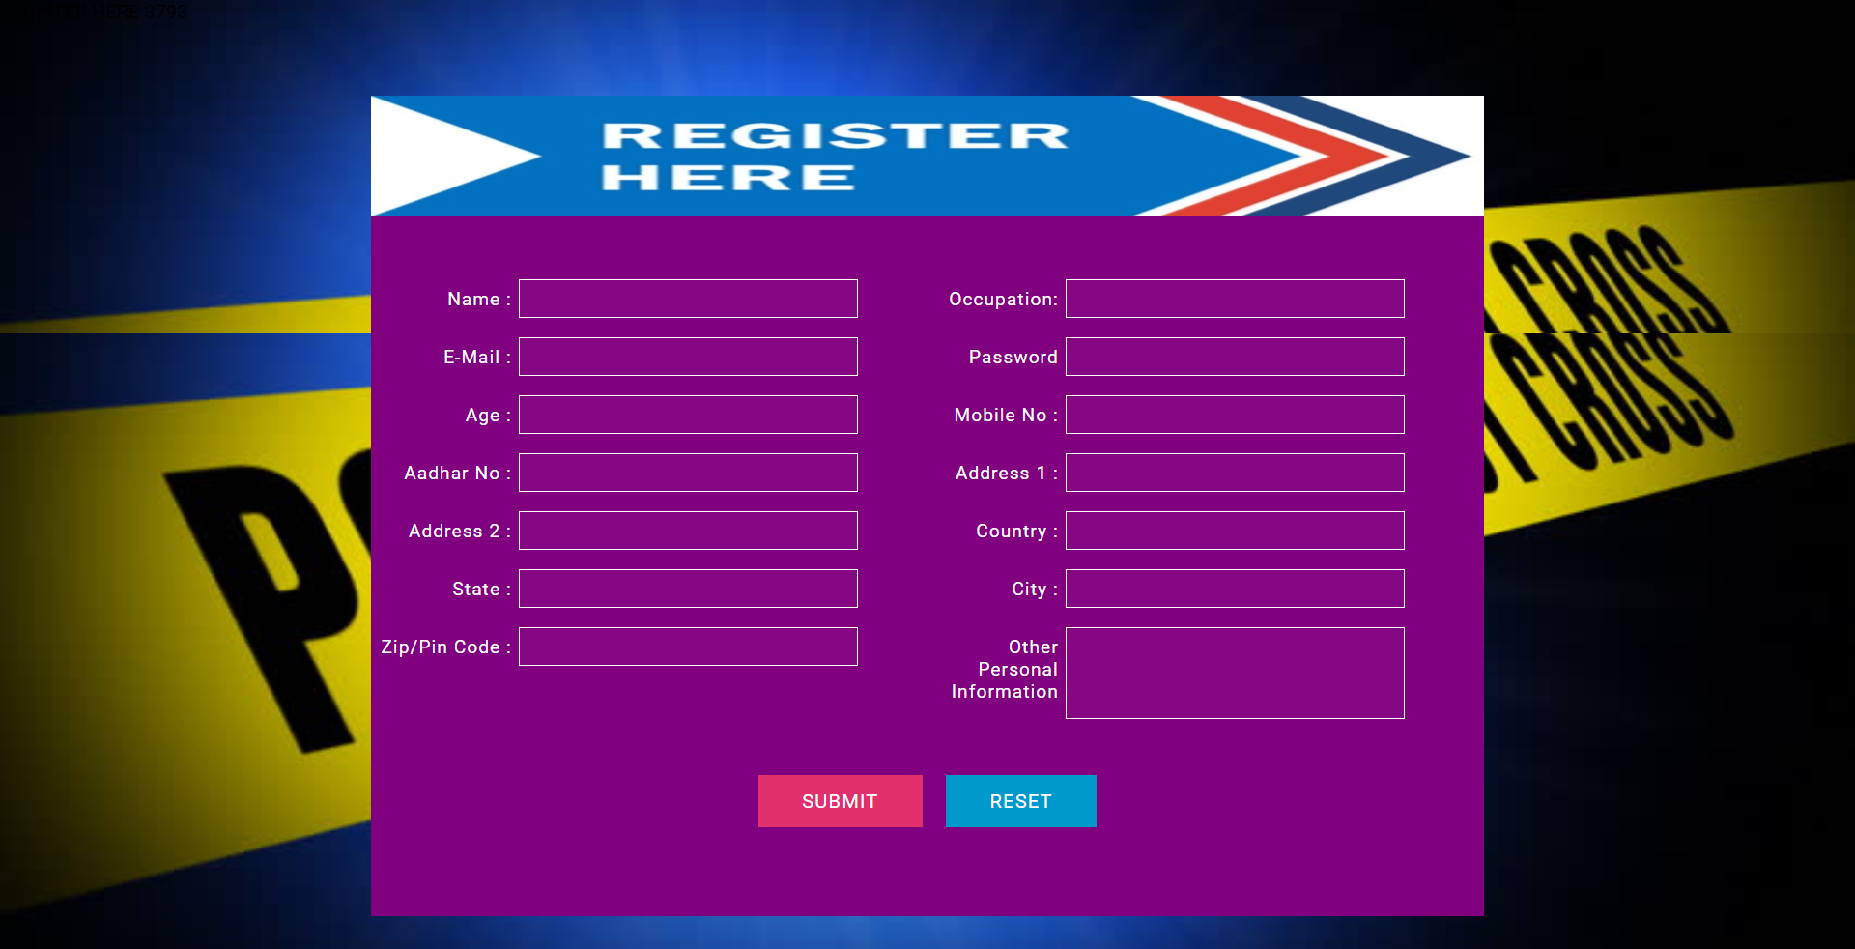
SNAPSHOTS
Register Here

Slide 24
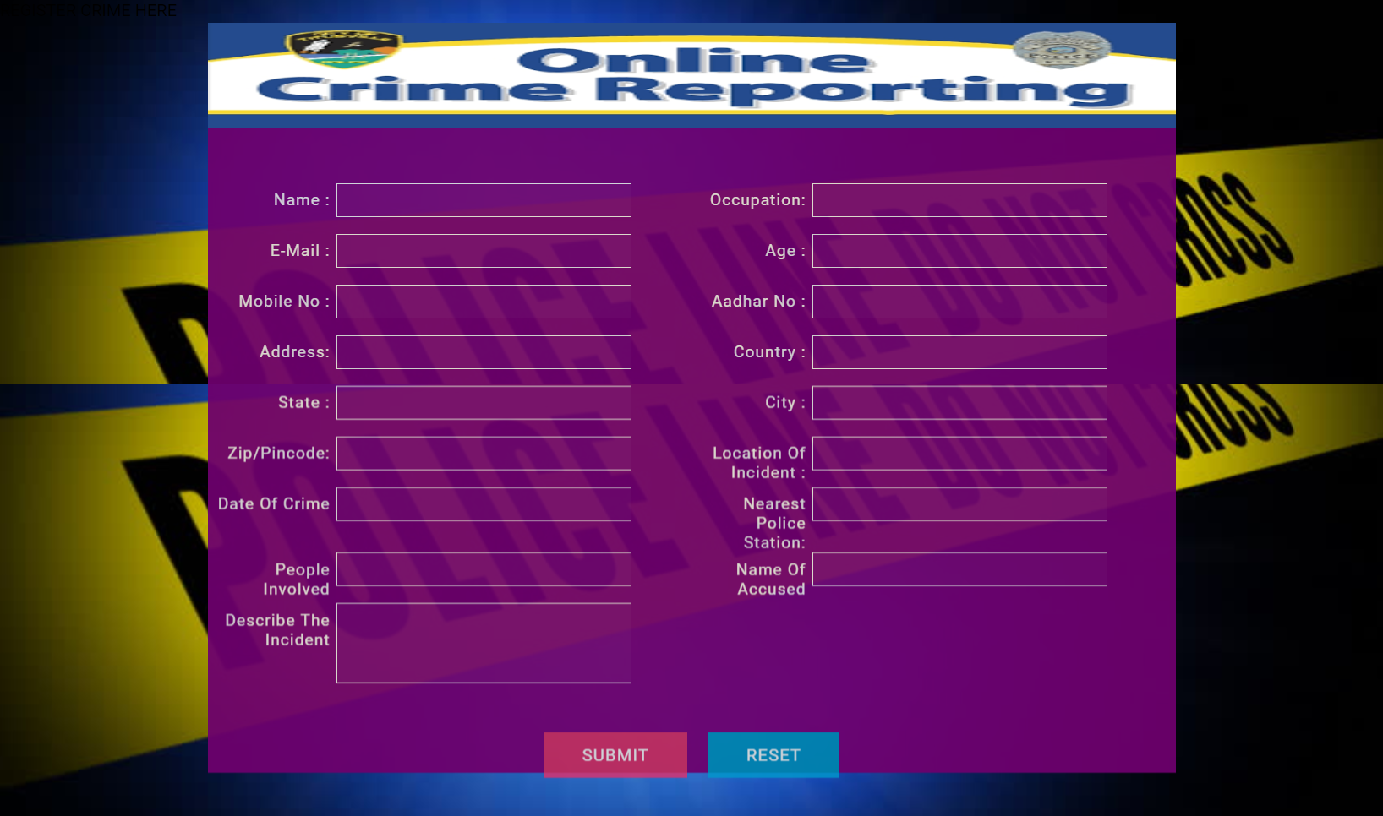
SNAPSHOTS
PAGE 1:INDEX PAGE
Register Complaint

Slide 25
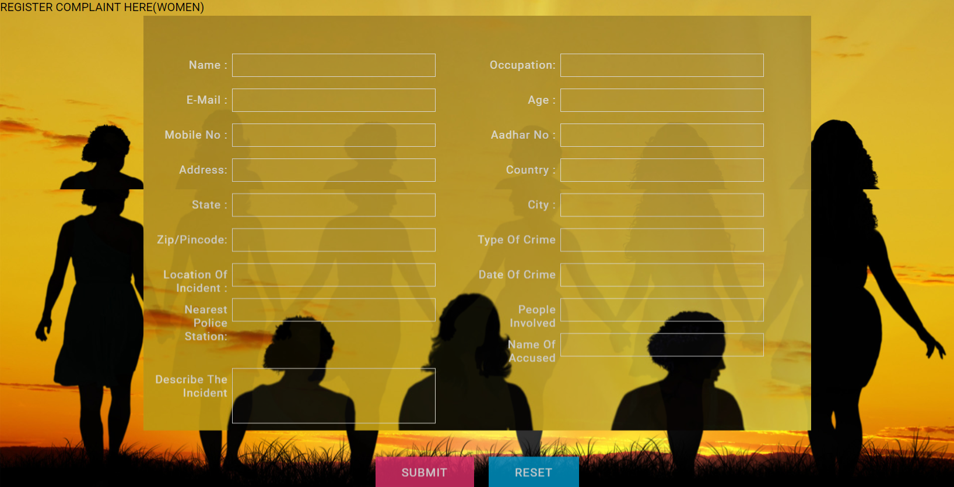
SNAPSHOTS
Women crime registration portal

Slide 26
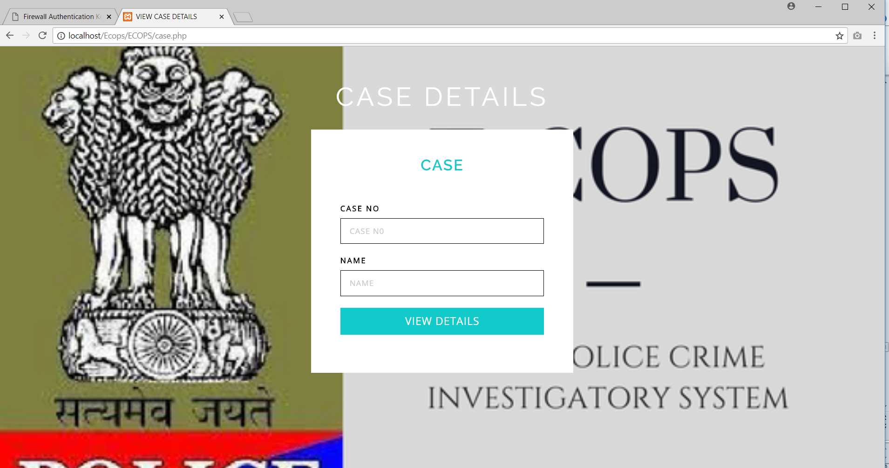

Slide 27
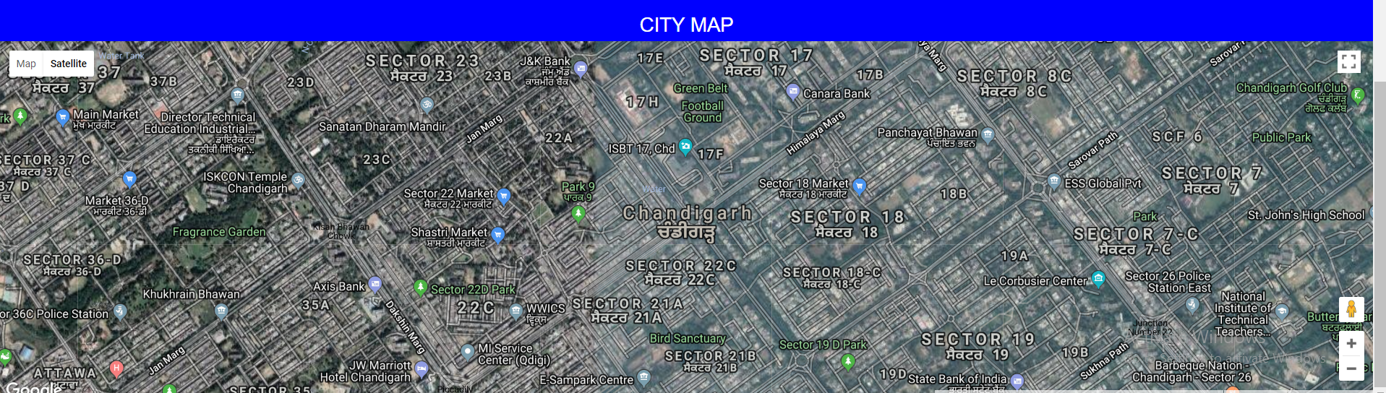
SNAPSHOTS

Slide 28

Feedback

Slide 29
RESULT
The topic result is said to be the benefits of the project. As this project will allow user to register complaints and view several data. This will also saving lot of time. Using this website every person feeling safe and confident around the world.
So in the points result will be---
1. Understanding of HTML, CSS ,PHP,Jscript.
2. Getting deep knowledge of development of project.
3. Understanding the concept of phpmysql practically.

Slide 30
CONCLUSION
The project titled as “E-COPS Online Police Investigatory System” is a web based application. This application provides facility for reporting online crimes, complaints. This software is developed with scalability in mind. Additional modules can be easily added when necessary. The software is developed with modular approach. All modules in the system have been tested with valid data and invalid data and everything work successfully. Thus the system has fulfilled all the objectives identified and is able to replace the existing system.
The project has been completed successfully with the maximum satisfaction of the organization. The constraints are met and overcome successfully. The system is designed as like it was decided in the design phase. The project gives good idea on developing a full-fledged application satisfying the user requirements.
The system is very flexible and versatile. This software has a user-friendly screen that enables the user to use without any inconvenience. Validation checks induced have greatly reduced errors. Provisions have been made to upgrade the software. The application has been tested with live data and has provided a successful result. Hence the software has proved to work efficiently.

Slide 31
REFERENCES
[1]. https://en.wikipedia.org/wiki/HTML [2].https://www.tutorialspoint.com/php/index.htm
[3]. https://ips.gov.in/
[4].https://en.wikipedia.org/wiki/Indian_Police_Service [5]. https://www.w3schools.com/css/
[6]. PHP and MYSQL web development by Luke Welling

